Slide 1
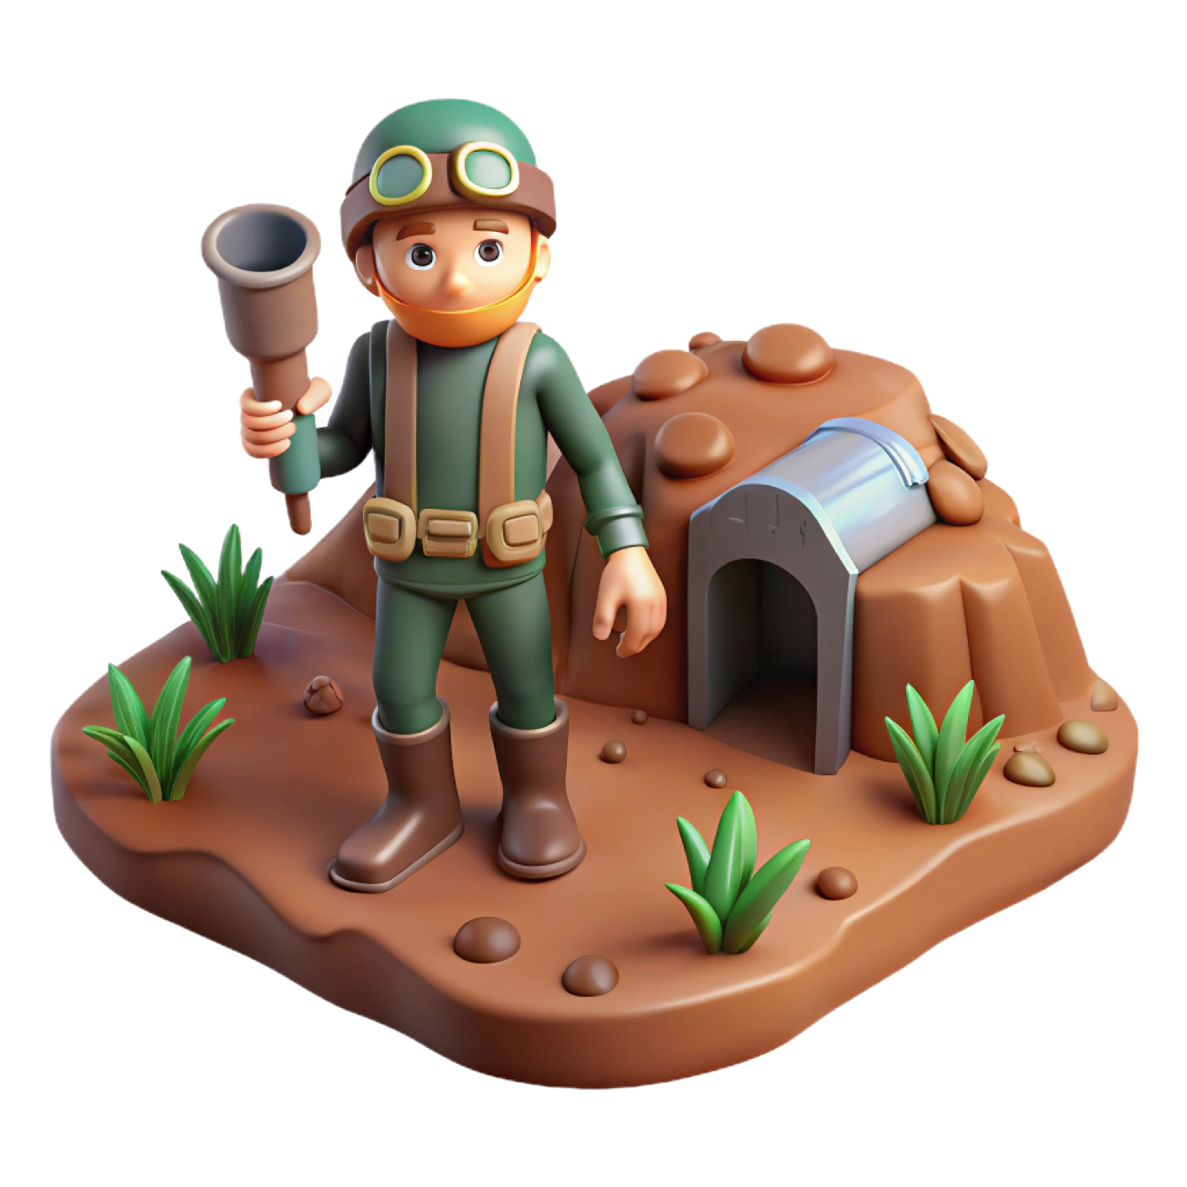
Underground Hero Navigation System
Player Login
Player Login
Play
Player
Registration
About the Game
Last
requirement
Game
Summary
Game starts
Fill 6 Boxes
Menu
Player Achievements
Player
History
Theme Picker
Level
Counter clock
Player Profile
Hero Leader board

Slide 2
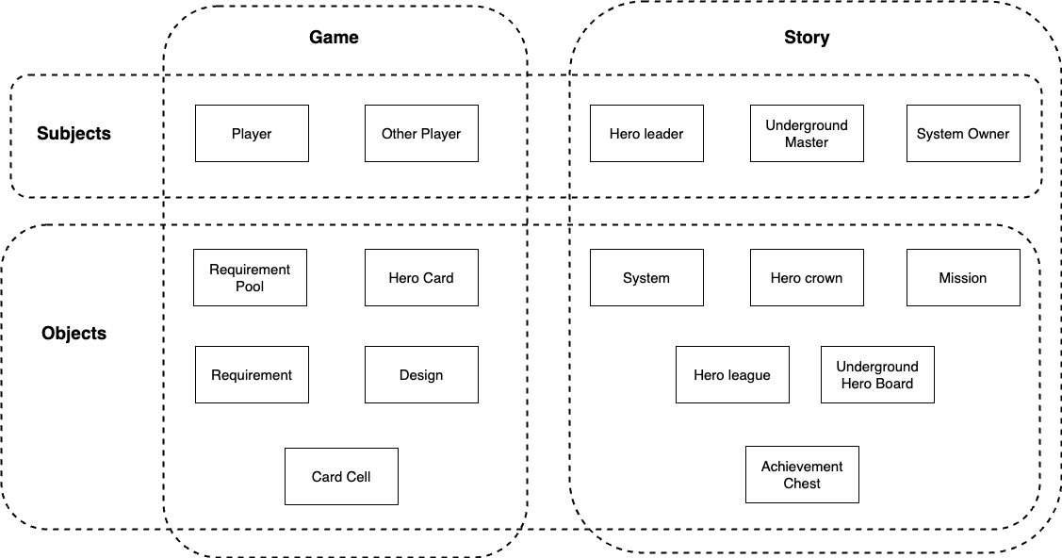
Underground Hero Subjects and Objects

Slide 3
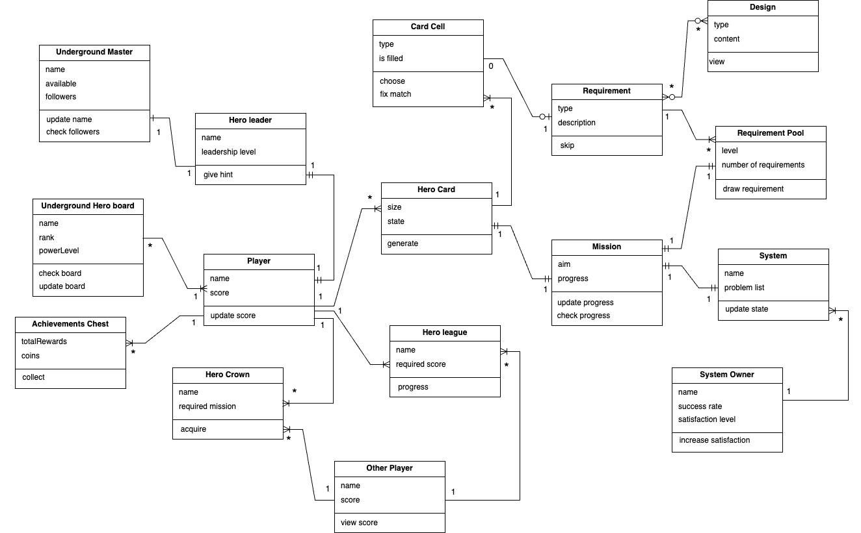

Underground Hero Associations

